Slide 1
Head Controlled Human Interface Device for Persons with Limited Hand Movement
Georgia Institute of Technology
School of Electrical and Computer Engineering
ECE 4007
Dr. Arthur Koblasz
Augmented Comm Group
Roberto Pereira
Seth Stewart
Jarius Tillman
Sarvagya Vaish
March 14, 2013

Slide 2
Overview
Prototype system to enable patients with spinal cord injury and limited hand mobility, to interface with a computer.
Estimated Cost
Component | Cost
9 DOF Sensor Stick (IMU) | $100.00
Arduino Due | $50.00
Wires and Headers | $15.00
Optical Flow, Mouse Sensor (OFS) | $0.00 | (donated)
Custom PCB | $0.00 | (donated)
3D Printed Plastic Housing | $0.00 | (donated)
Total Cost | $165.00

Slide 3
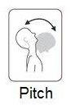
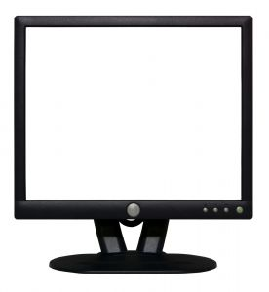
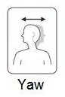
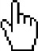
Technical Objectives
Translate head pitch and yaw movements to computer cursor displacement
Translate eyebrow raises and winces to left and right clicks, respectively

Slide 4
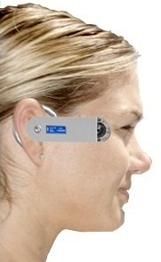
Design Objectives
Integrate all components into a small wearable device

Slide 5
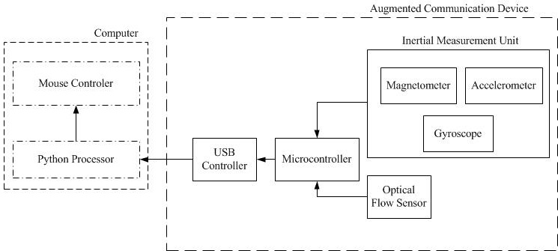
Modified Hardware Block Diagram

Slide 6
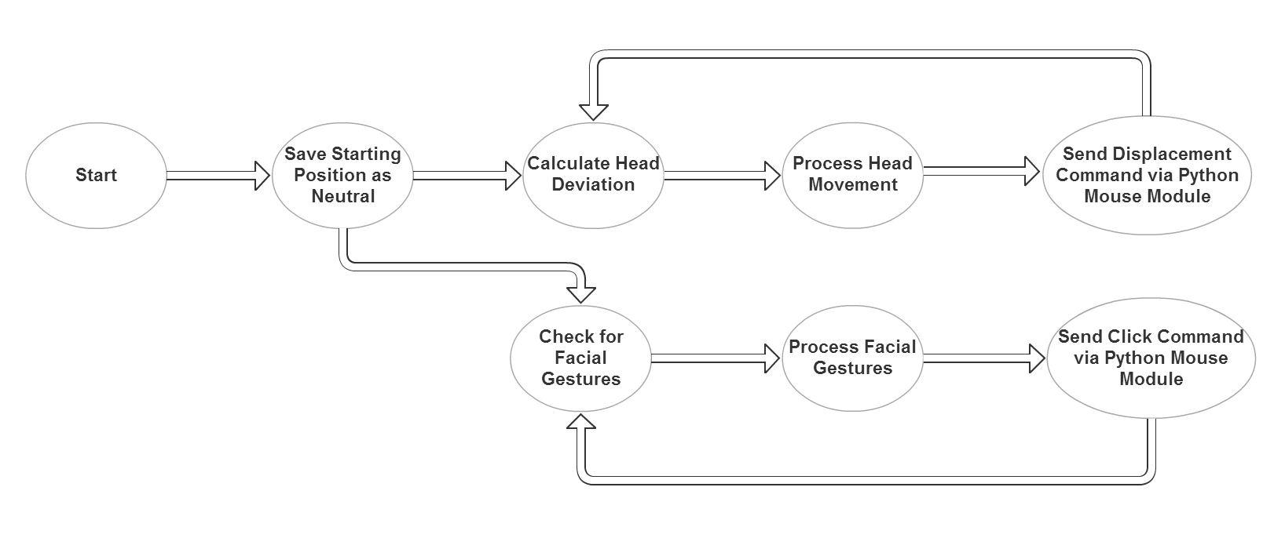
Modified Control Flowchart
Sensor data processing moved from Arduino (on-chip) to the host computer

Slide 7
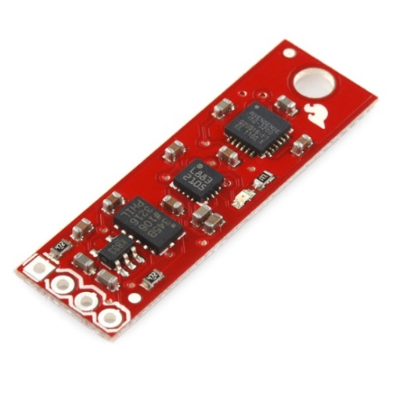
Current Status – Head Tracking
Purchased IMU sensor from Sparkfun
Used Arduino program to convert head movements to digital signals
Created Processing program to translate digital signals to cursor movements
SparkFun - $100
Demo

Slide 8



Head Tracking Algorithm
$C=Cursor Positions$ (x, y)
$$C_{t=0}=(\frac{screen_{width}}{2},\frac{screen_{height}}{2})$$
$$S=Sensor Readings (yaw, pitch)$$
$$S_{n}=Neutral Position Sensor Readings$$
At every time step -
$$C_{t}= C_{t−1}+ α\left(S_{t}{ −S}_{n}\right)+β{\left(S_{t}−S_{n}\right)}^{2}$$
The neutral position moves towards the cursor
$$S_{n+1}= S_{n}+ γ\left(C_{t}\right)$$
New Cursor
Position
Old Cursor
Position
Sensor displacement from Neutral position
Quadratic sum of differences
Adjustment Rate

Slide 9
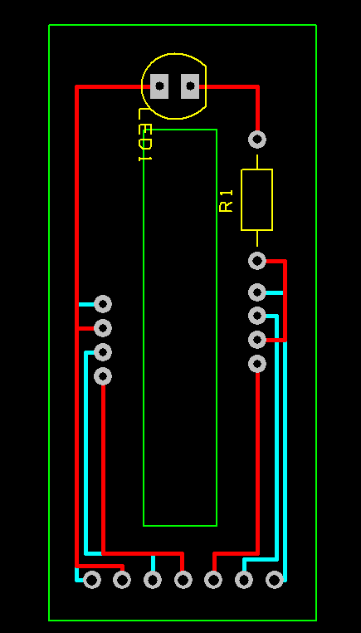
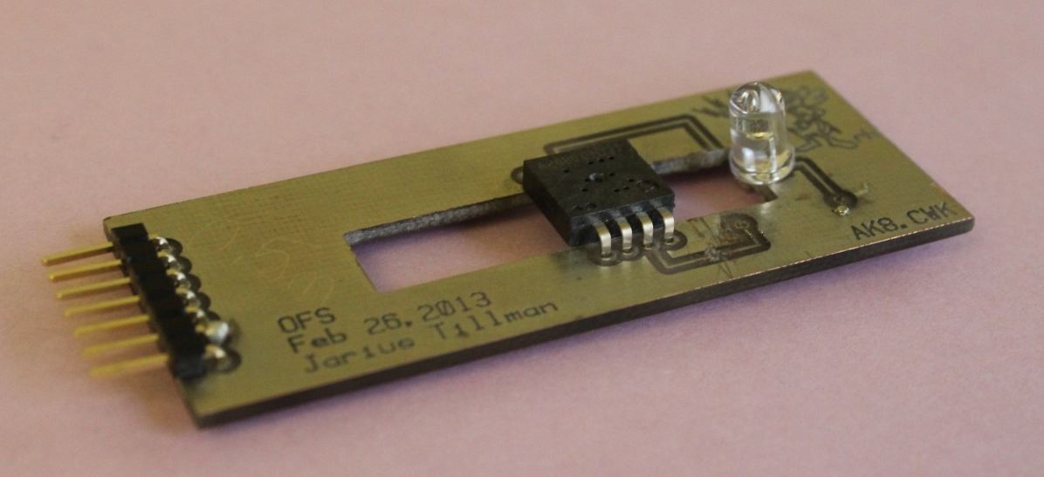
OFS Electronics
Optical Flow Sensor donated by PixArt Imaging
Created a custom PCB for holding the sensor
Header Pins for Wires
OFS
IR LED
PCB Design

Slide 10
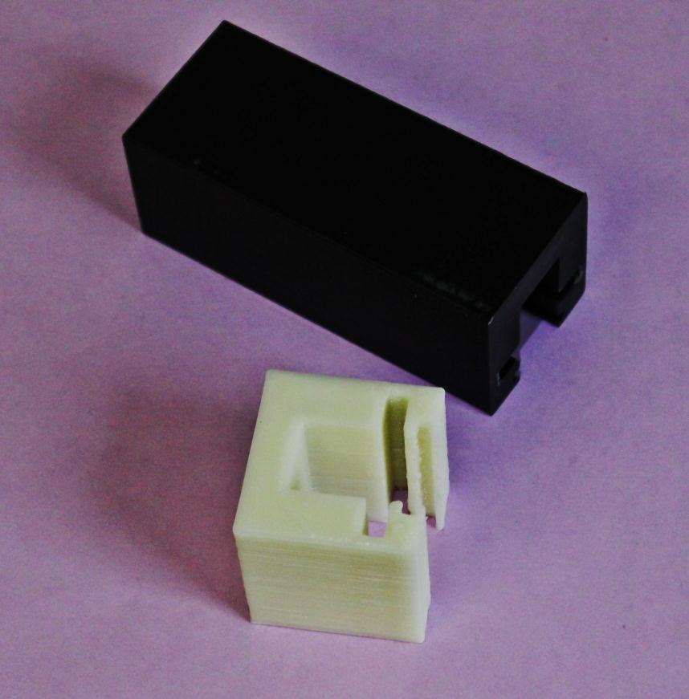
OFS Hardware
Iterating over 3D printed mounting to test PCB, lens, and OFS

Slide 11
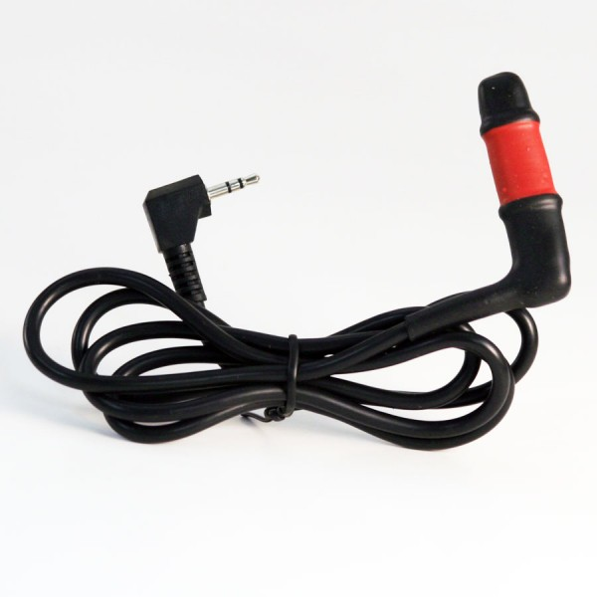
Current Issues
OFS recognizes skin movement only when placed at a particular distance from the skin
Need to create an adjustable mounting system
Alternatives
Bite-switch
Recognize nods and head shakes using IMU
Bite-switch

Slide 12
Project Schedule
Activity | Date
1. Continue working with OFS | March 24
2. Find and implement OFS alternative (in case point 1 fails) | April 7
3. Fabricate mounting for sensors | April 14
4. Test and remove bugs | April 21
5. Senior Design Expo | April 25

